Slide 1

Hotel Reservation Analysis
Presented By
Aishwarya S

Slide 2
OVERVIEW
To analyze hotel reservation dataset to gain insights into guest preferences, booking trends, and other key factors that impact the hotel's operations.
Database used- SQL Server Management Studio 2019

Slide 3
Introduction
Project objective
To analyze the hotel reservation data and provide insights for data driven decision and to enhance the customer satisfaction.

Slide 4
Dataset Details:
The dataset includes the following columns:
• Booking_ID: A unique identifier for each hotel reservation.
• no_of_adults: The number of adults in the reservation.
• no_of_children: The number of children in the reservation.
• no_of_weekend_nights: The number of nights in the reservation that fall on
weekends.
• no_of_week_nights: The number of nights in the reservation that fall on
weekdays.
• type_of_meal_plan: The meal plan chosen by the guests.
• room_type_reserved: The type of room reserved by the guests.
• lead_time: The number of days between booking and arrival.
• arrival_date: The date of arrival.
• market_segment_type: The market segment to which the reservation
belongs.
• avg_price_per_room: The average price per room in the reservation.
• booking_status: The status of the booking.

Slide 5
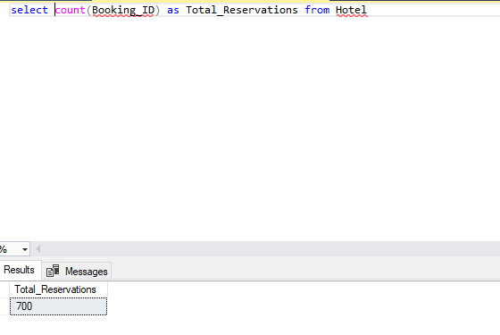
SQL query of Hotel Reservation Analysis
What is the total number of reservations in the dataset?

Slide 6
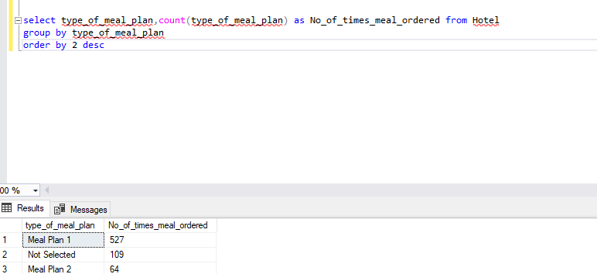
2. Which meal plan is the most popular among guests?

Slide 7
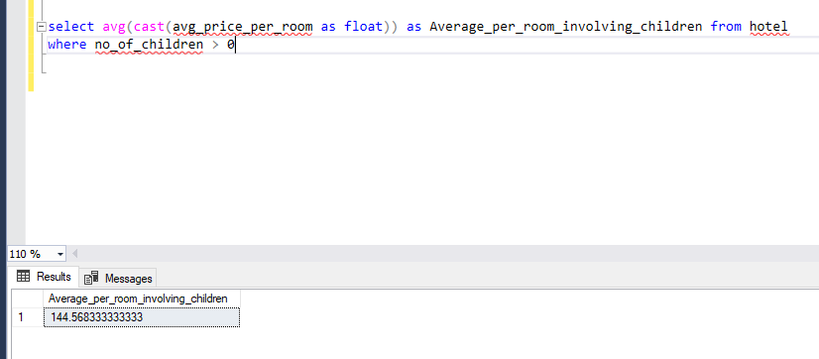
3. What is the average price per room for reservations involving children?

Slide 8
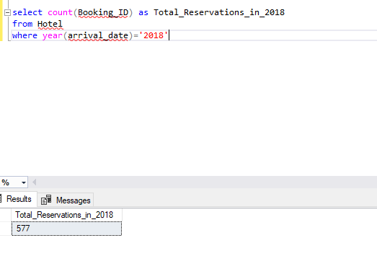
4. How many reservations were made for the year 20XX (replace XX with the desired year)?

Slide 9
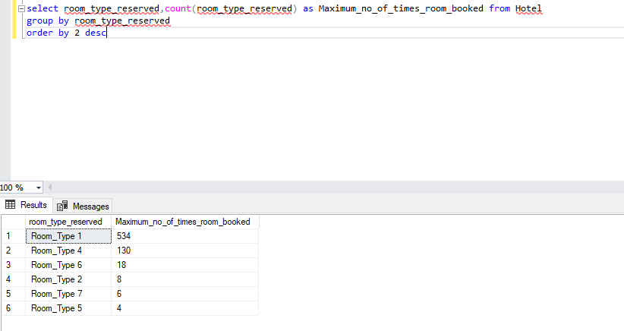
5. What is the most commonly booked room type?

Slide 10
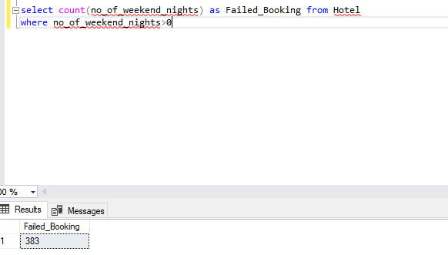
6. How many reservations fall on a weekend (no_of_weekend_nights > 0)?

Slide 11
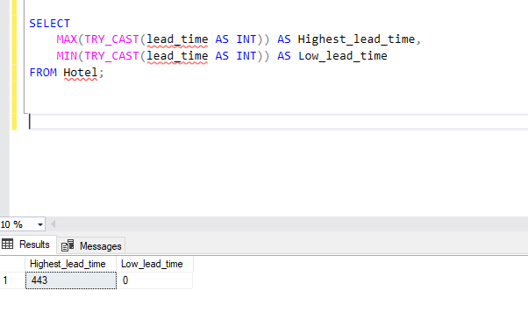
7. What is the highest and lowest lead time for reservations?

Slide 12
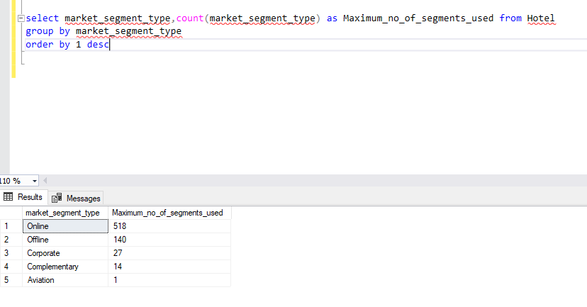
8. What is the most common market segment type for reservations?

Slide 13
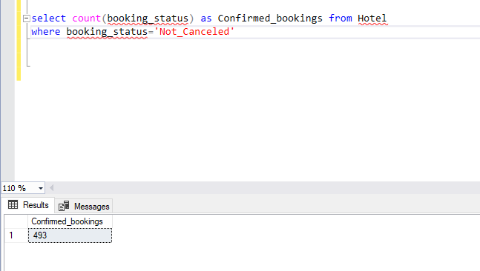
9. How many reservations have a booking status of "Confirmed"?

Slide 14
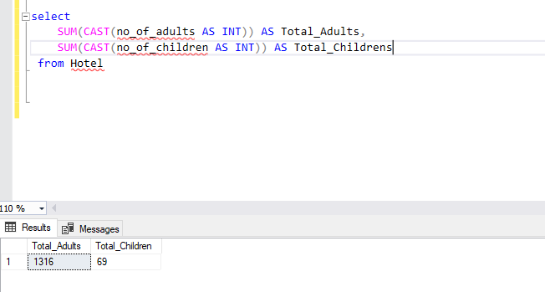
10. What is the total number of adults and children across all reservations?

Slide 15
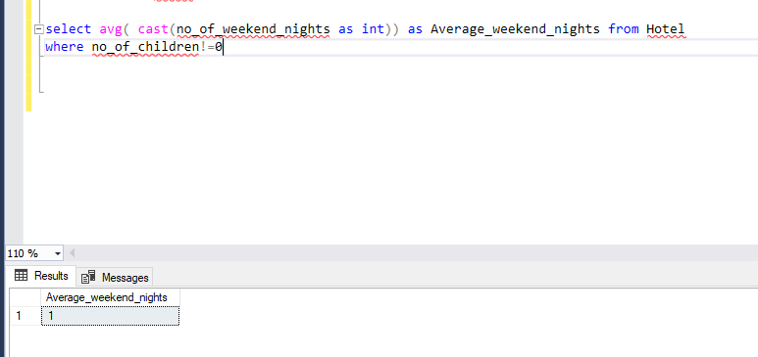
11. What is the average number of weekend nights for reservations involving children?

Slide 16
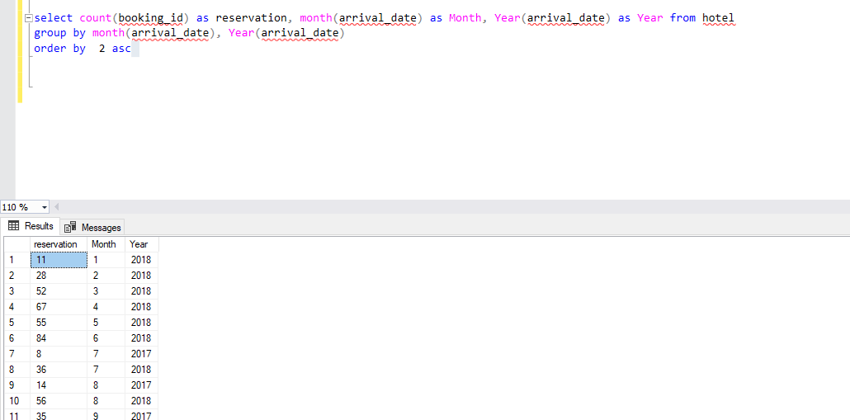
12. How many reservations were made in each month of the year?

Slide 17
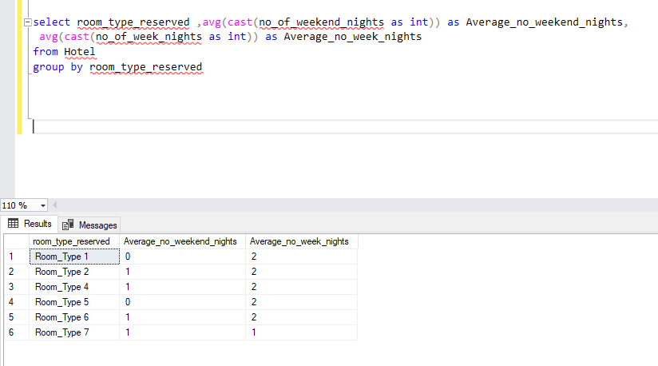
13. What is the average number of nights (both weekend and weekday) spent by guests for each room type?

Slide 18
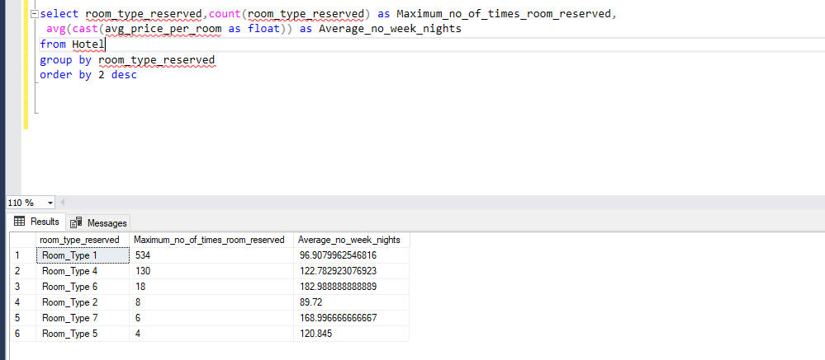
14. For reservations involving children, what is the most common room type, and what is the average price for that room type?

Slide 19
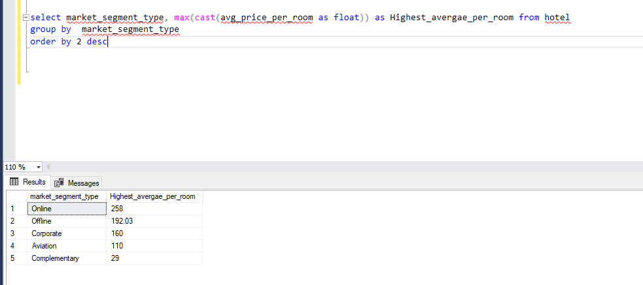
15. Find the market segment type that generates the highest average price per room.

Slide 20
Conclusion
The analysis indicates that data-driven insights are essential for optimizing hotel operations and enhancing guest experiences. Understanding booking trends and guest preferences can lead to more effective marketing strategies and improved customer satisfaction and revenue.SQL has proven to be an invaluable tool in extracting and analyzing large datasets to derive actionable insights.

Slide 21
THANK YOU

